Slide 1
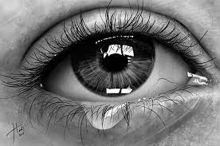
Dear
From

Slide 2
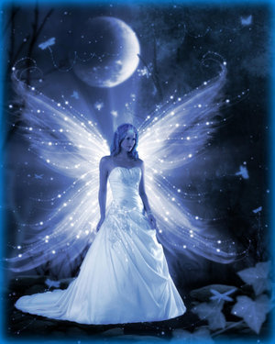
Dear
From

Slide 3

Dear
From

Slide 4

Dear
From

Slide 5
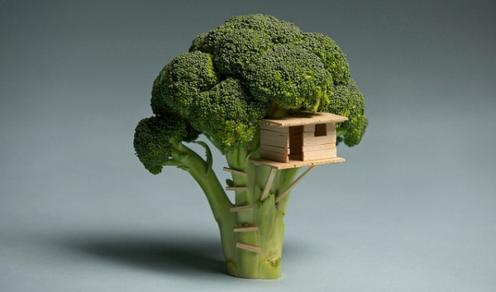
Dear
From

Slide 6
Dear
From

Slide 7

Dear
From

Slide 8

Dear
From

Slide 9

Dear
From

Slide 10
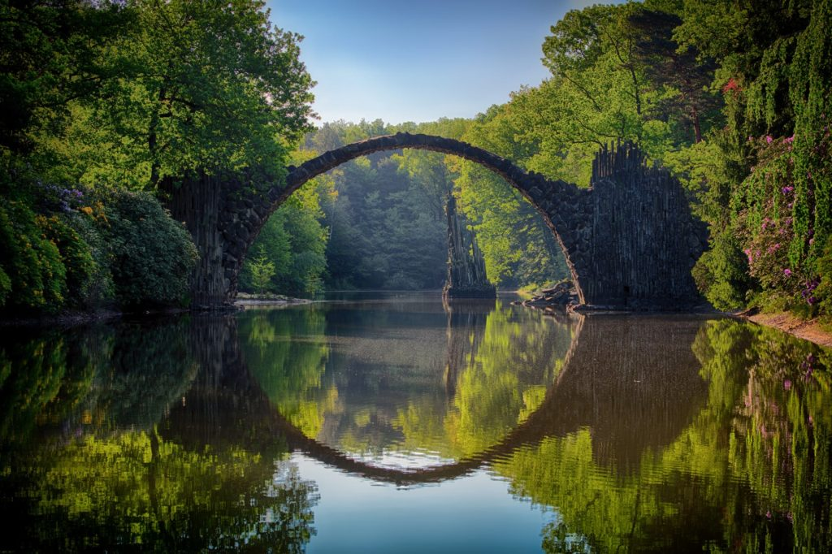
Dear
From

Slide 11

Dear
From

Slide 12

Dear
From

Slide 13

Dear
From

Slide 14

Dear
From

Slide 15

Dear
From

Slide 16

Dear
From

Slide 17

Dear
From

Slide 18

Dear
From

Slide 19
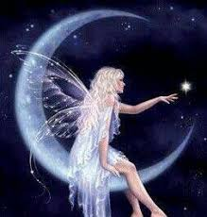
Dear
From

Slide 20

Dear
From

Slide 21

Dear
From

Slide 22
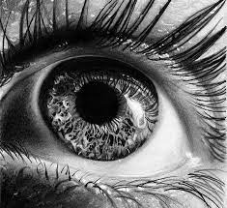
Dear
From

Slide 23
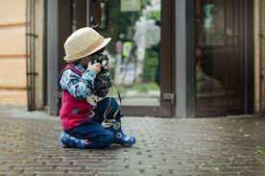

Dear
Dear
From
From

Slide 24

Dear
From

Slide 25

Dear
From

Slide 26

Dear
From

Slide 27


Dear
Dear
From
From

Slide 28
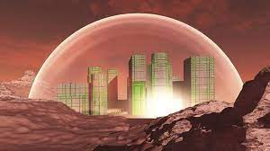
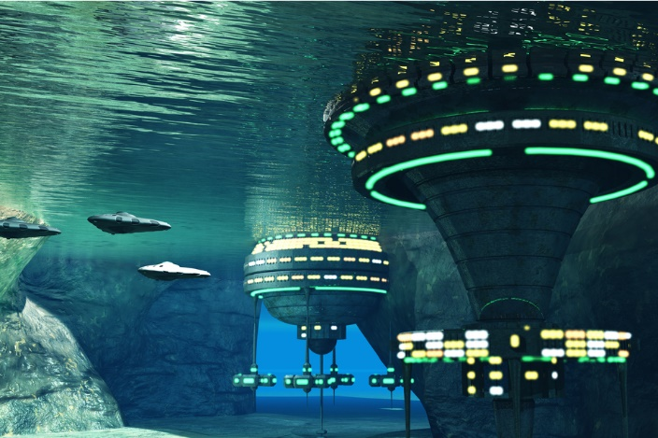
Dear
Dear
From
From

Slide 29
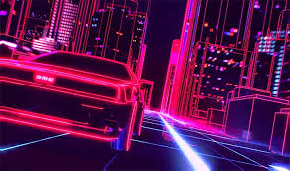
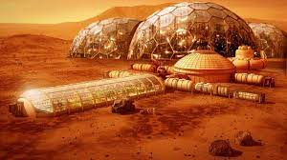
Dear
Dear
From
From

Slide 30


Dear
Dear
From
From

Slide 31

Dear
From

Slide 32

Dear
From

Slide 33


Dear
Dear
From
From

Slide 34


Dear
Dear
From
From

Slide 35


Dear
Dear
From
From

Slide 36
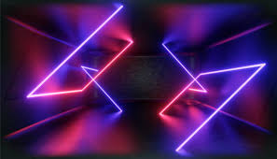
Dear
From

Slide 37


Dear
Dear
From
From

Slide 38

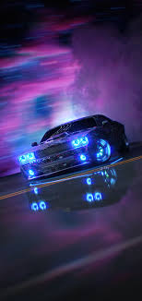
Dear
Dear
From
From

Slide 39


Dear
Dear
From
From

Slide 40


Dear
Dear
From
From

Slide 41


Dear
Dear
From
From

Slide 42



Dear
Dear
Dear
From
From
From

Slide 43

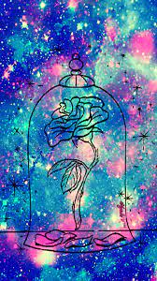

Dear
Dear
Dear
From
From
From

Slide 44



Dear
Dear
Dear
From
From
From

Slide 45


Dear
Dear
From
From

Slide 46


Dear
Dear
From
From

Slide 47


Dear
Dear
From
From

Slide 48

Dear
From

Slide 49

Dear
From

Slide 50

Dear
From

Slide 51

Dear
From

Slide 52

Dear
From

Slide 53

Dear
From

Slide 54

Dear
From

Slide 55

Dear
From

Slide 56

Dear
From

Slide 57

Dear
From

Slide 58

Dear
From

Slide 59


Dear
Dear
From
From

Slide 60

Dear
From

Slide 61

Dear
From

Slide 62

Dear
From

Slide 63
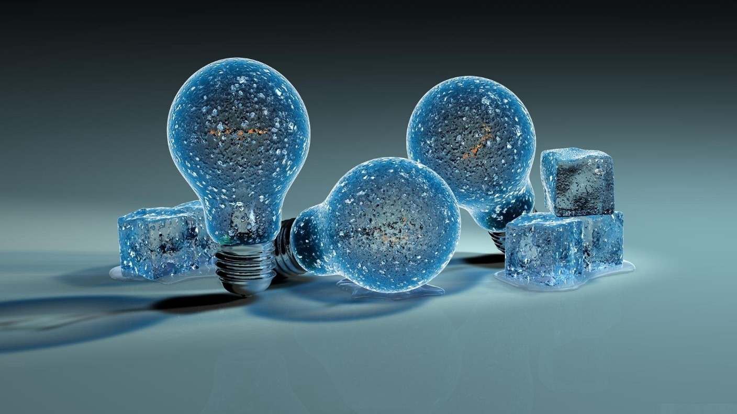
Dear
From

Slide 64
Dear
From

Slide 65

Dear
From

Slide 66

Dear
From

Slide 67


Dear
Dear
From
From

Slide 68
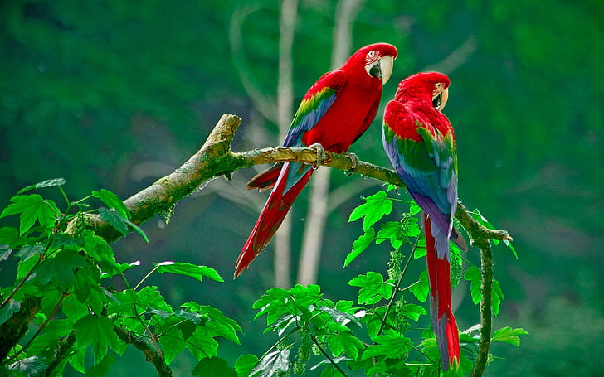
Dear
From

Slide 69
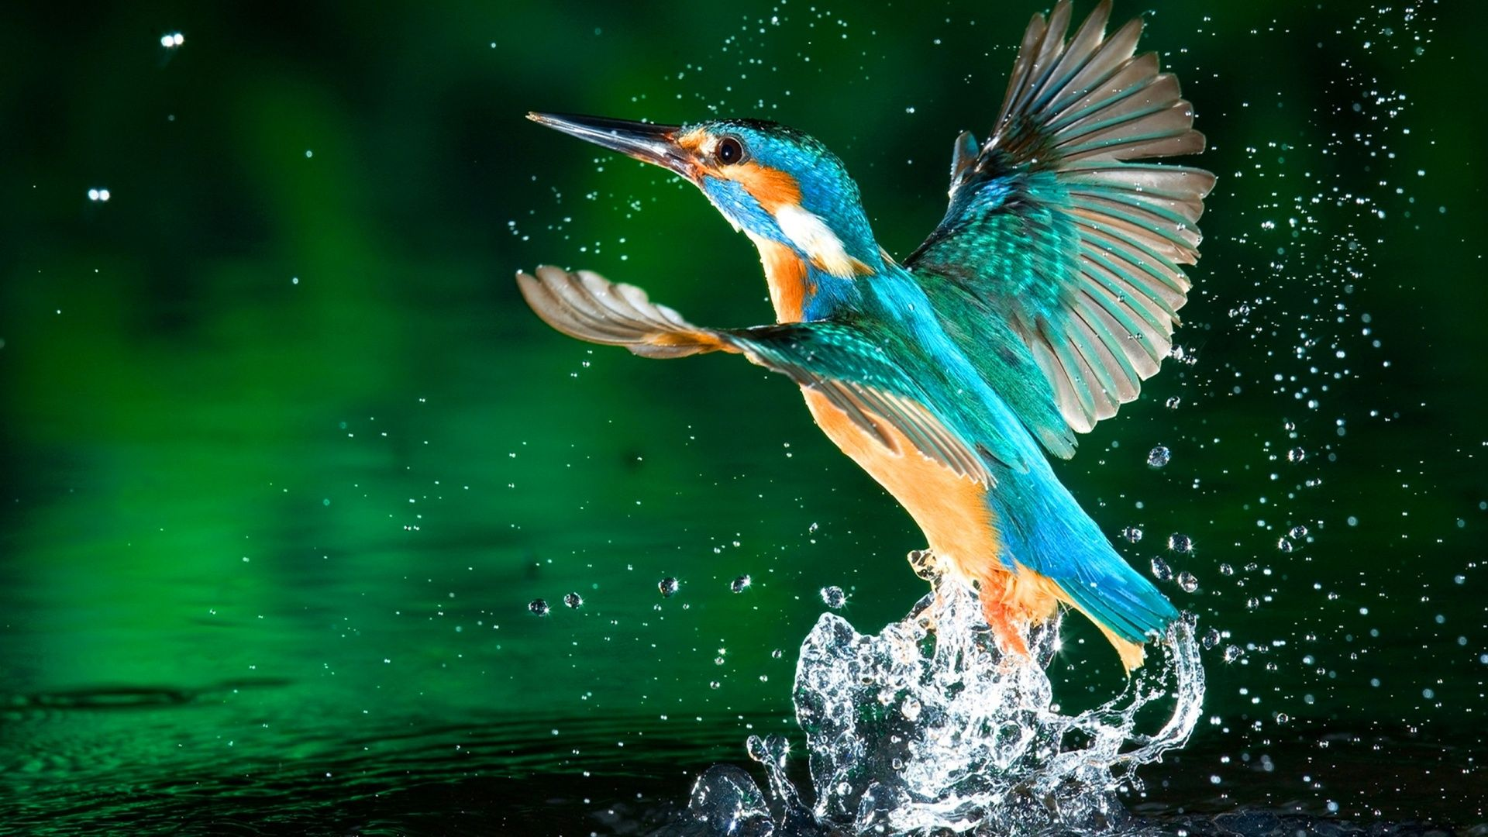
Dear
From

Slide 70

Dear
From

Slide 71
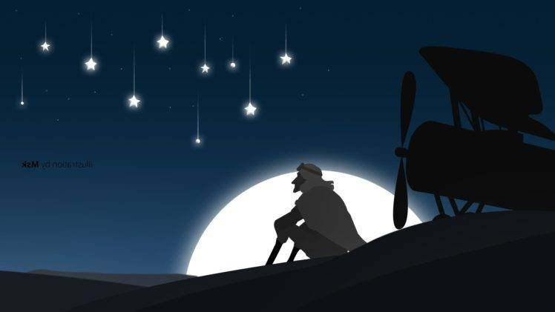
Dear
From

Slide 72

Dear
From

Slide 73


Dear
Dear
From
From

Slide 74

Dear
His
Her
From

Slide 75

Dear
From

Slide 76
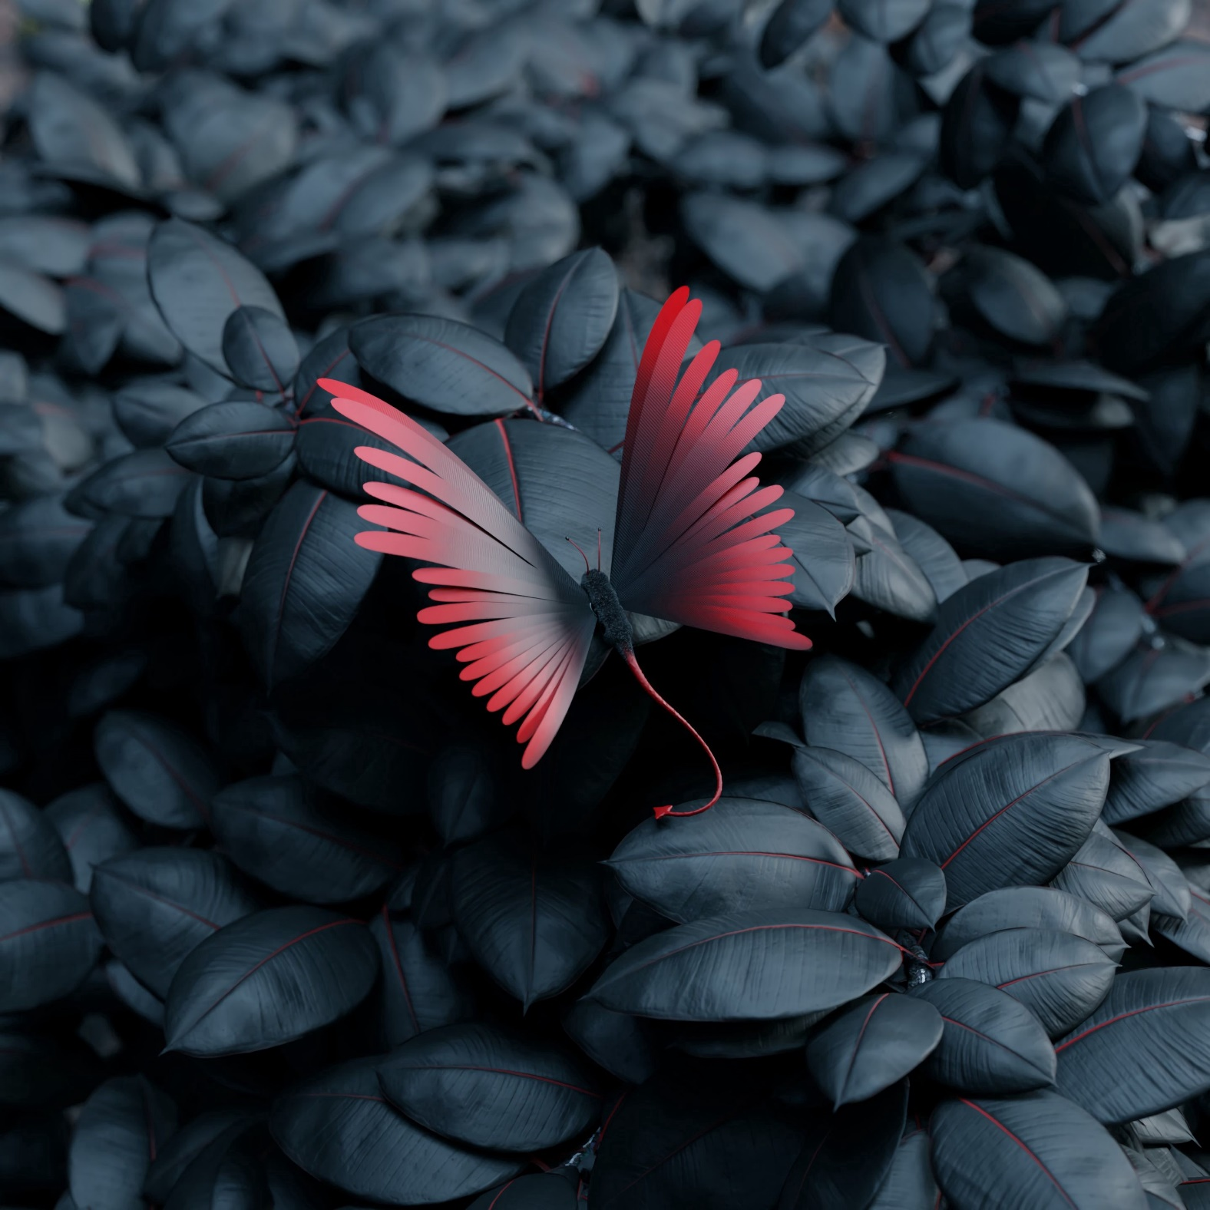

Dear
Dear
From
From

Slide 77

Dear
From

Slide 78

Dear
From

Slide 79

Dear
From

Slide 80

Dear
From

Slide 81

Dear
From

Slide 82

Dear
From

Slide 104

Dear
From

Slide 105

Dear
From

Slide 106

Dear
From

Slide 107


Dear
Dear
From
From

Slide 108

Dear
From

Slide 109

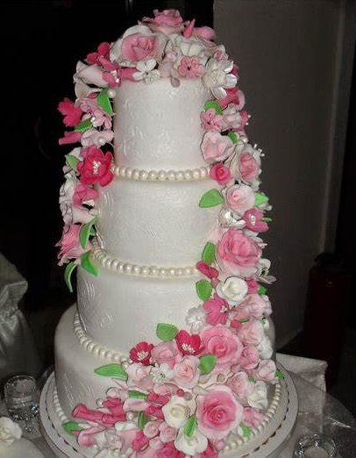
Dear
Dear
From
From

Slide 110


Dear
Dear
From
From

Slide 111
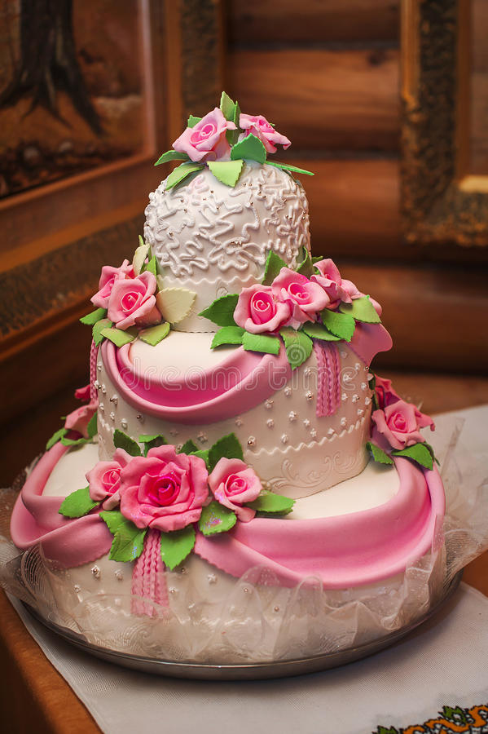
Dear
From

Slide 112
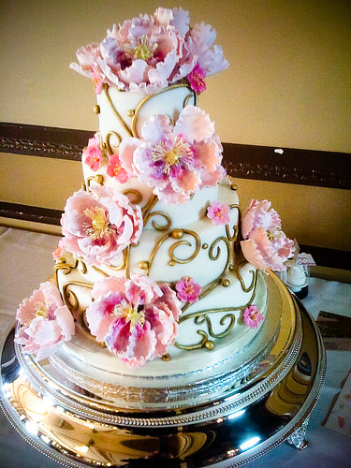
Dear
From

Slide 113
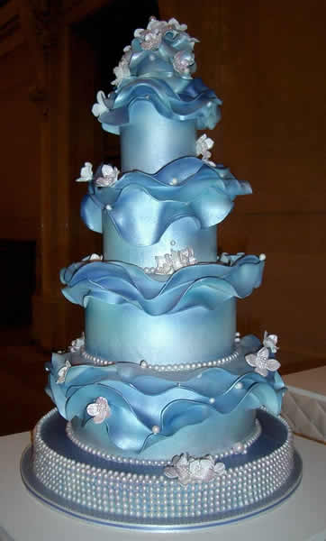
Dear
From

Slide 114

Dear
From

Slide 115

Dear
From

Slide 116

Dear
From

Slide 117

Dear
From

Slide 118
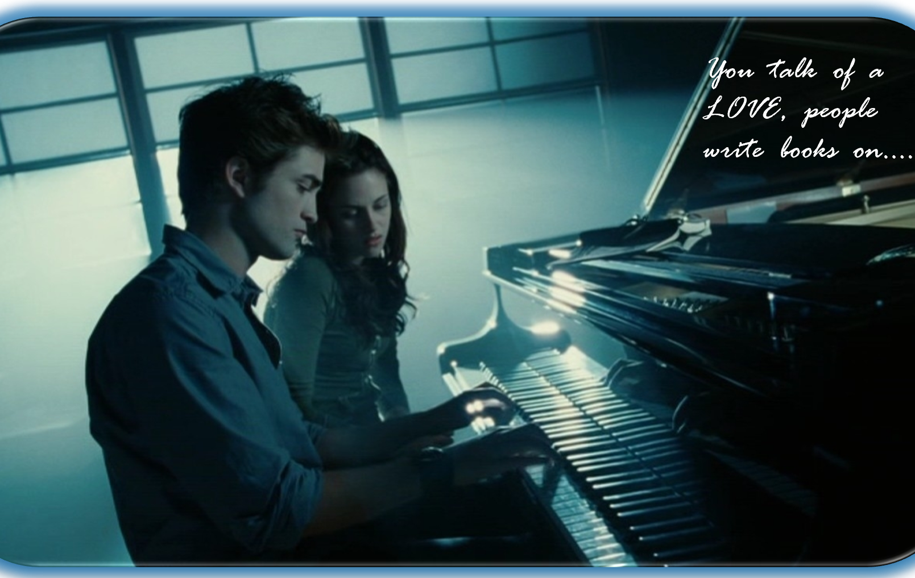
Dear
From

Slide 119
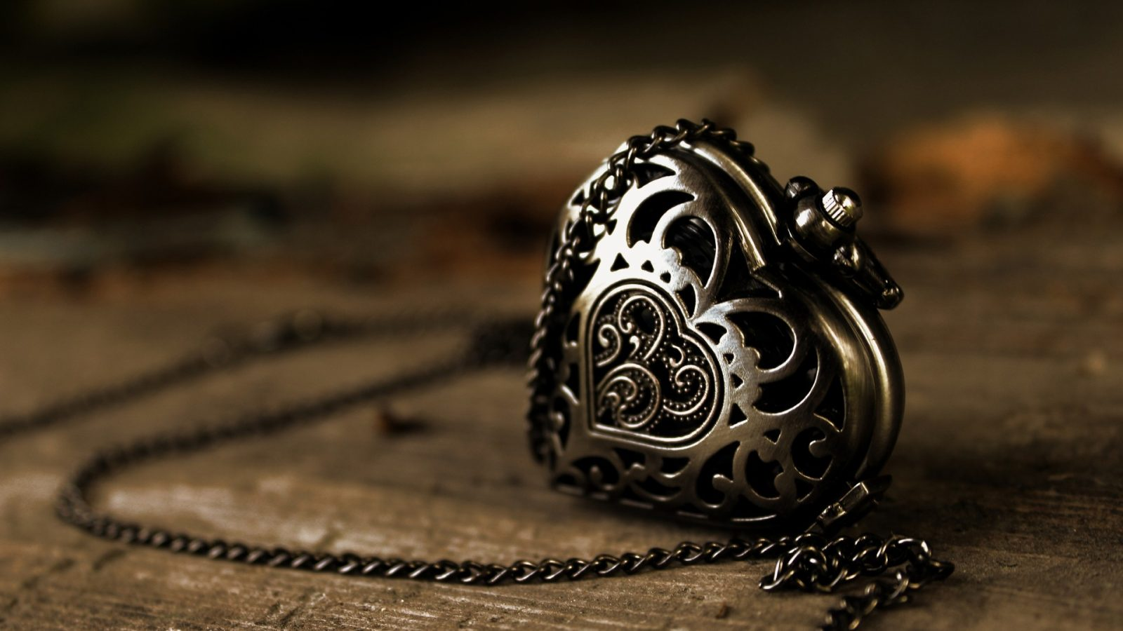
Dear
From

Slide 120

Dear
From

Slide 121

Dear
From

Slide 122
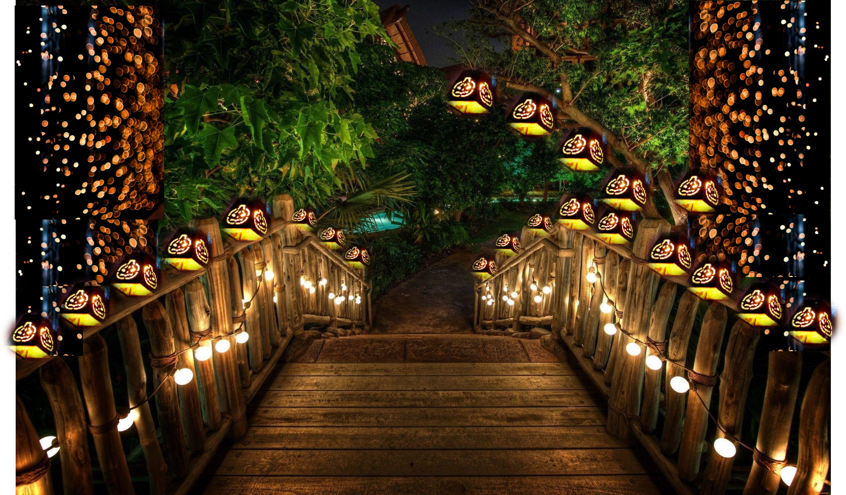
Dear
From

Slide 123

Dear
From

Slide 124
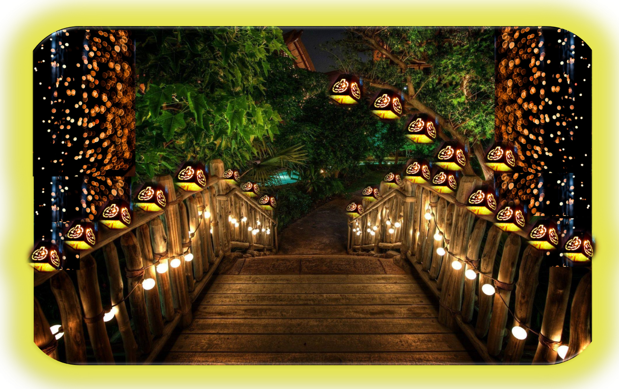
Dear
From

Slide 125

Dear
From

Slide 126

Dear
From

Slide 127
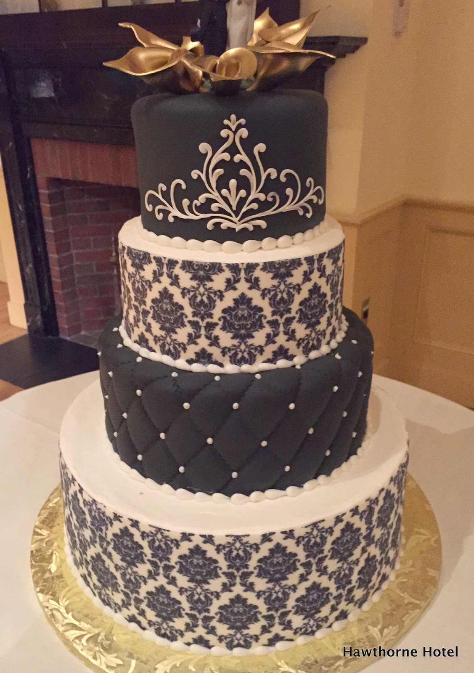
Dear
From

Slide 128

Dear
From

Slide 129

Dear
From

Slide 130

Dear
From

Slide 131

Dear
From

Slide 132

Dear
From

Slide 133

Dear
From

Slide 134

Dear
From

Slide 135
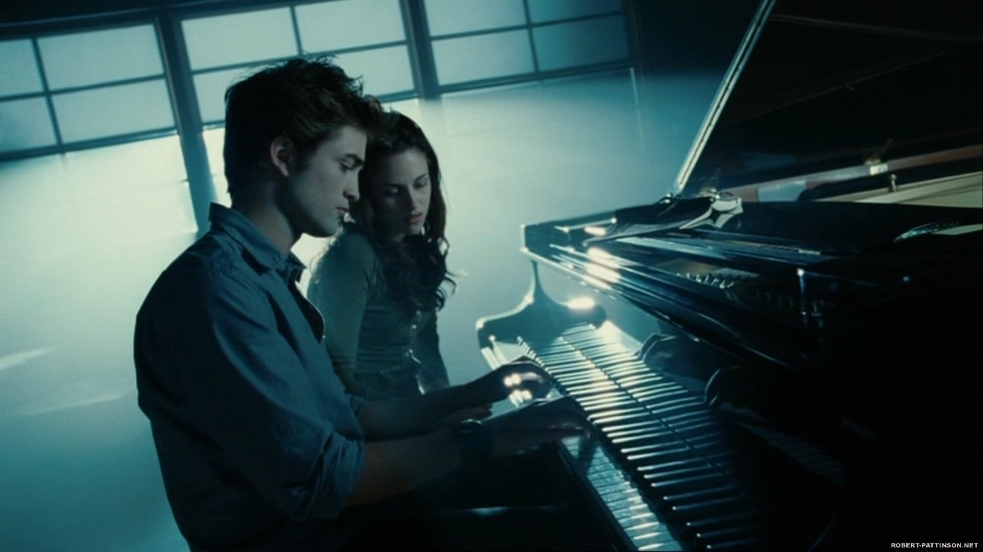
Dear
From

Slide 136

Dear
From

Slide 137

Dear
From

Slide 138
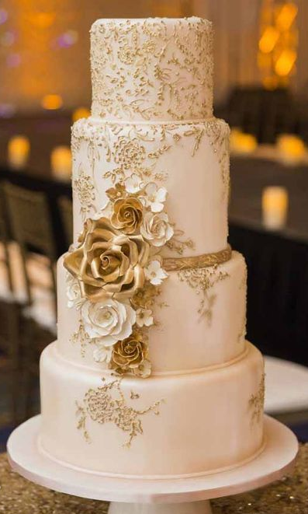
Dear
From

Slide 139

Dear
From

Slide 140

Dear
From

Slide 141
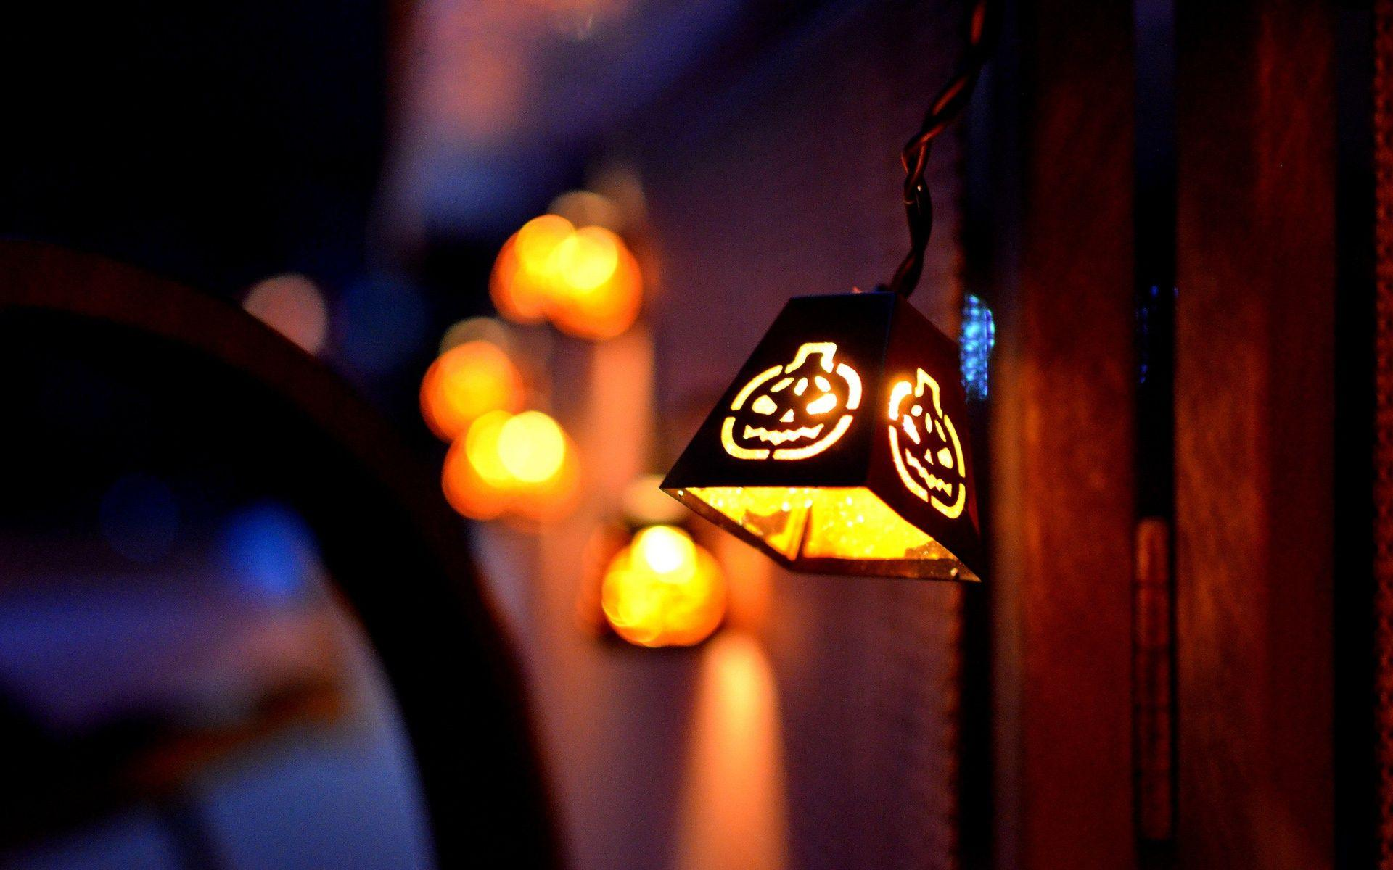
Dear
From

Slide 142

Dear
From

Slide 143
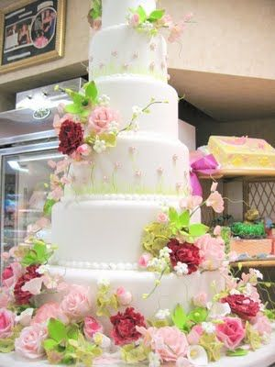
Dear
From

Slide 144

Dear
From

Slide 145

Dear
From

Slide 146

Dear
From

Slide 147
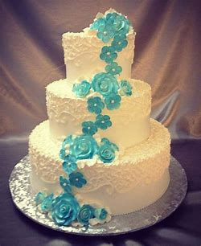
Dear
From

Slide 148
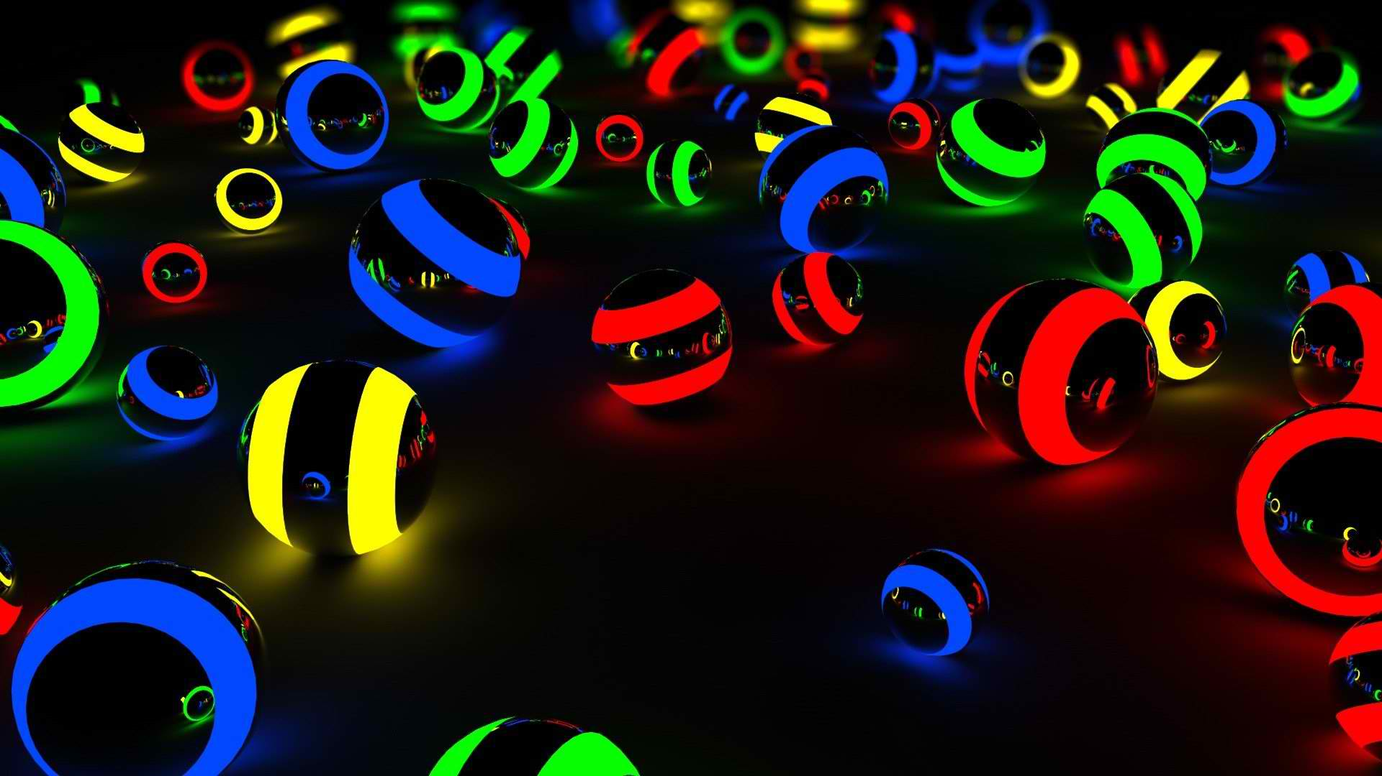
Dear
From

Slide 149

Dear
From

Slide 150

Dear
From

Slide 151

Dear
From

Slide 152

Dear
From

Slide 153

Dear
From

Slide 154
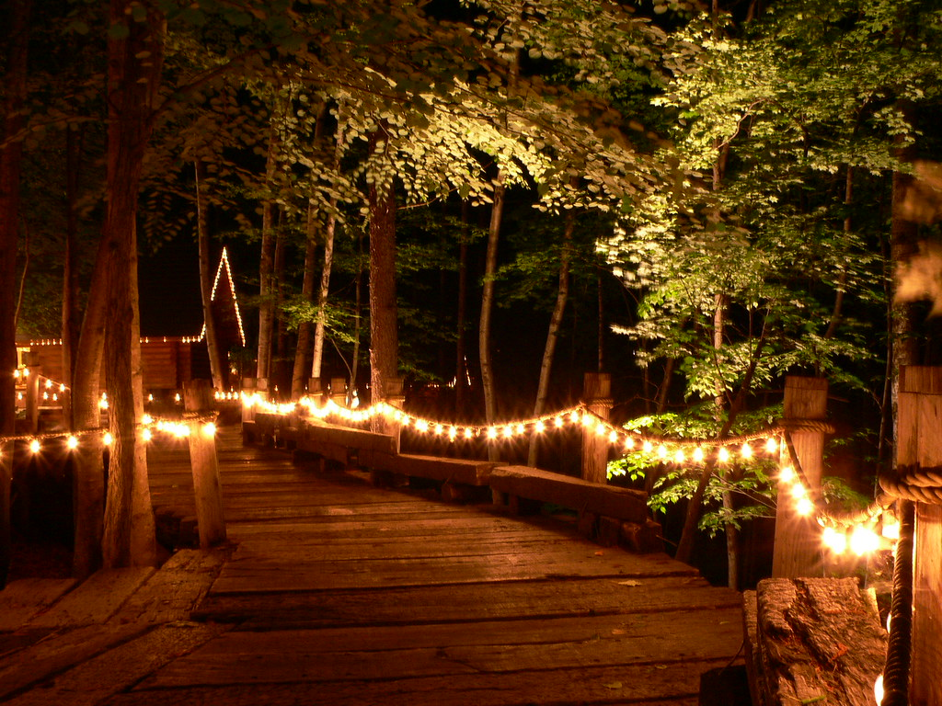
Dear
From

Slide 155

Dear
From

Slide 156

DEAR
From

Slide 157

Dear
From

Slide 158

Dear
From

Slide 159

Dear
From

Slide 160

Dear
From

Slide 161
Dear
From

Slide 162

Dear
From

Slide 163

Dear
From

Slide 164
Dear
From

Slide 165


Dear
From

Slide 166

Dear
From

Slide 167
Dear
From

Slide 168

Dear
From

Slide 169

Dear
From

Slide 170
Dear
From

Slide 171

Dear
From

Slide 172

Dear
From

Slide 173
Dear
From

Slide 174

Dear
From

